Slide 1
Module 1 - Biodiversity and Ecosystem Services
Training Modules for Applying the Mitigation Hierarchy:
Planning Policy and Projects for No Net Loss or a Net Gain of Biodiversity
Module 1
Biodiversity and ecosystem services:
what are they, why do they matter and
what is causing their loss?

Slide 2
Biodiversity and Ecosystem Services Module – Abstract
This module on ‘Biodiversity and Ecosystem Services’ explains the subject of this training course – biodiversity – so that all the other modules touching on ‘Biodiversity Net Gain’, mitigation of impacts on biodiversity and similar concepts are clear.
It covers key definitions, explores the role and importance of biodiversity and why it is under threat. The module shows why attention to mitigating impacts on biodiversity is particularly important in the context of today’s unprecedented losses of biodiversity.

Slide 3
Biodiversity and Ecosystem Services Module - Contents
Contents | Slides
What is biodiversity and what is an ecosystem? | 3-8
What are the benefits of biodiversity and ecosystem services? | 9-11
What are the threats to biodiversity and ecosystem services? What is being lost? | 12-14
What are the dangers to people from losing biodiversity? | 15
Take home messages | 16

Slide 4
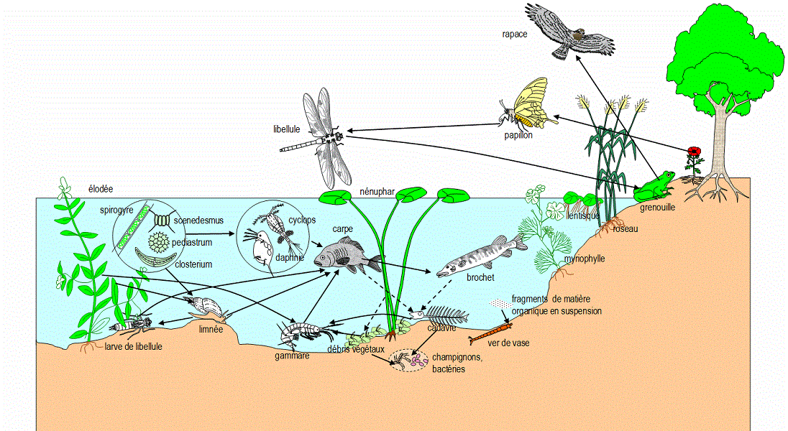
What is the definition of biodiversity?
Biodiversity (or biological diversity) is composed of two words – ‘bio’ (from the Greek βίος- meaning ‘life’) and ‘diversity’, referring to the diversity of life on earth.
Biodiversity is the richness of the diversity of all forms of life, namely, genes, species and ecosystems.
A formal definition can be found in Article 2 of the Convention on Biological Diversity.

Slide 5
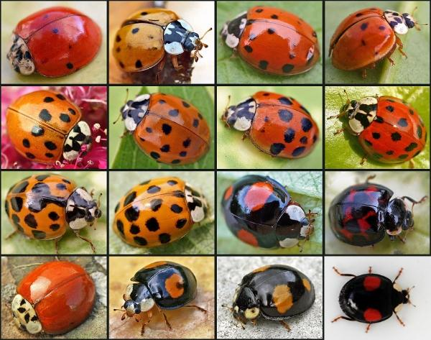
Genetic diversity
What are the different levels of biodiversity?
Genetic diversity is characterised by the diversity of alleles within a species or population.
It is a difficult level of diversity to study, and takes a great deal of time.
For
example:
One can see that these ladybirds are all different because each of them has different alleles.

Slide 6
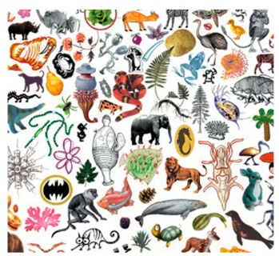
What are the different levels of biodiversity?
Species diversity
Species diversity is the number and variability of living species such as animals, fungi or humans.
Example:
The image illustrates many different species found on earth, such as the elephant, the lion, a particular species of tree, etc ...

Slide 7
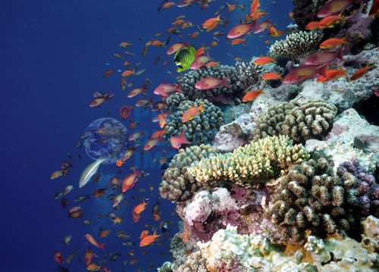
What are the different levels of biodiversity?
Ecosystem diversity
Ecosystem diversity is the interaction between all natural spaces such as forests, deserts, rivers ... and living organisms such as humans for example.
Example:
Marine animals (fish, etc.) often live often near this reef environment with its corals and algae. They are interacting with this natural area.

Slide 8
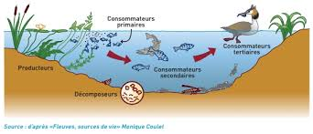
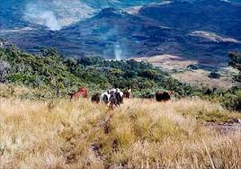
What is an ecosystem?
An ecosystem is a dynamic set of living organisms (plants, animals and micro-organisms) that interact with each other and with the environment (soil, climate, water, light) in which they live.
The dimensions of ecosystems can vary considerably; they can be very small, such as a pond or a dead tree, or be gigantic, like the Earth.
Large ecosystems are generally described as:
- aquatic ecosystems: in salt water or in fresh water;
- terrestrial ecosystems: forests, grasslands, deserts, etc.

Slide 9
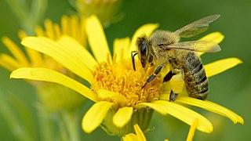
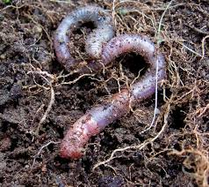
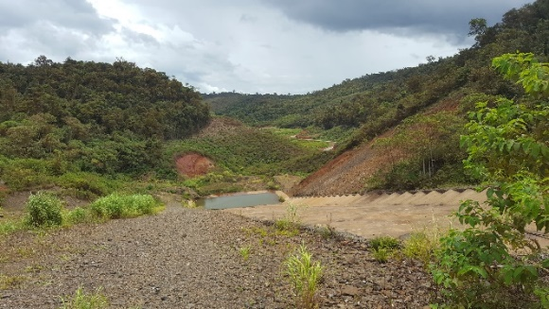
What is the role of biodiversity?
Biodiversity is essential for the natural development of all the ecosystems of our planet. High biodiversity increases the stability and adaptability of the biosphere to changing environmental conditions.
Biodiversity offers 'ecosystem services' - irreplaceable goods and services essential to our daily lives - oxygen, food, medicines and many raw materials:
Animals, especially insects, pollinate a multitude of plants. Without pollination, most fruits and vegetables would disappear;
Species, such as the earthworm, contribute to soil fertility;
Plants, especially in wetlands, contribute to purification;
Wetlands protect against coastal erosion, mitigate flood and flood intensity, helping to combat the effects of climate change.

Slide 10
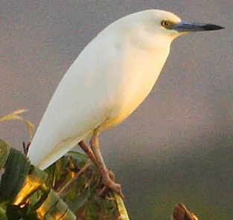
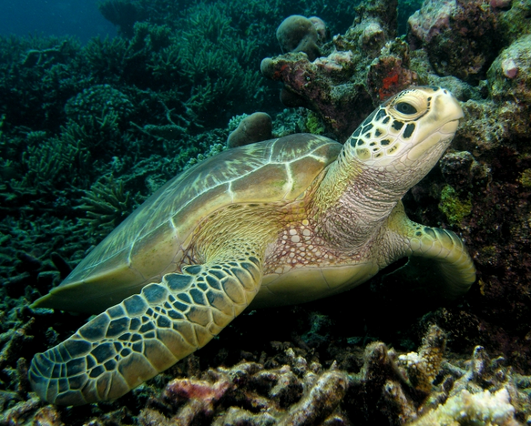
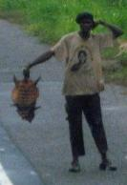
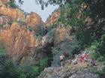
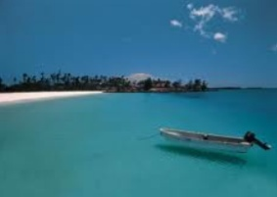
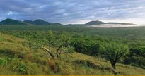
Key biodiversity components matrix
Biodiversity Component | Intrinsic Values (Vulnerability, irreplaceability) | Use Values | Cultural Values
Species | Threatened species; restricted range and/or endemic species; congregatory species | Species providing fuel, fiber, food, medicines, etc. | Totem species
Habitats/ Communities/ Assemblages | Rare or threatened habitat types; exemplary habitats | Recreational sites | Sacred sites (e.g. sacred groves, burial grounds); sites of aesthetic importance
Whole Landscapes / Ecosystems | Climate regulation; seed dispersal; pollination | Air and water quality regulation; soil fertility; pollination | E.g. Landscape-scale sacred sites
Photo Adam Ridley
A framework that helps assess which elements of biodiversity are affected by a project
Notes:
According to BBOP, the purpose of a biodiversity offset is to deliver no net loss of all the biodiversity offset components affected by the project. (Note: IFC PS6 differs slightly, focussing particularly for critical habitat on some elements of biodiversity.)
Although the goal of biodiversity offsets is no net loss or a net gain in overall type, amount, and condition of biodiversity, as a practical matter it is impossible to identify and measure the loss and gain of every single biodiversity component affected by a project or conserved through an offset.
A necessary step in evaluating losses and gains is therefore to identify biodiversity components that can be used to represent all biodiversity affected by the project. This subset of components is selected as being characteristic or representative of the biodiversity of the affected area, and/or important for intrinsic as well as use and cultural value, and termed the ‘key biodiversity components’ (KBCs). The KBCs are used in the offset to:
Help identify and evaluate the biodiversity impacts that the development project will have;
Help determine whether impacts can be offset (see Principle 2);
Help identify the offset activities needed to deliver gains to offset residual impacts;
Check that the offset design will deliver specific conservation outcomes;
Establish the ecological equivalence or ‘like for like or better’ comparison of losses and gains;
Inform the selection of the metrics that form the basis of the loss-gain calculation to demonstrate no net loss; and
Provide a basis to check that the offset sites and activities selected can deliver conservation gains for these KBCs, as a proxy for all the biodiversity affected by the project.
The Key Biodiversity Components Matrix illustrated here helps to classify biodiversity components at three levels: species; habitats/biological communities/assemblages; and ecosystems, and also the different values that need to be considered: the intrinsic (existence) values, and also affected people’s socioeconomic use and cultural values.
The offset is intended to address the entirety of biodiversity affected by the development project, but reviewing elements of the offset design against the KBCs, as above, can be a good way to check that this can happen.

Slide 11
Key biodiversity components matrix
Biodiversity Component | Intrinsic Values (Vulnerability, irreplaceability) | Use Values | Cultural Values
Species | Threatened species; restricted range and/or endemic species; congregatory species | Species providing fuel, fiber, food, medicines, etc. | Totem species
Habitats/ Communities/ Assemblages | Rare or threatened habitat types; exemplary habitats | Recreational sites | Sacred sites (e.g. sacred groves, burial grounds); sites of aesthetic importance
Whole Landscapes / Ecosystems | Climate regulation; seed dispersal; pollination | Air and water quality regulation; soil fertility; pollination | E.g. Landscape-scale sacred sites
Photo Adam Ridley
Ecosystem Services
Notes:
According to BBOP, the purpose of a biodiversity offset is to deliver no net loss of all the biodiversity offset components affected by the project. (Note: IFC PS6 differs slightly, focussing particularly for critical habitat on some elements of biodiversity.)
Although the goal of biodiversity offsets is no net loss or a net gain in overall type, amount, and condition of biodiversity, as a practical matter it is impossible to identify and measure the loss and gain of every single biodiversity component affected by a project or conserved through an offset.
Consequently, identifying a subset of biodiversity components and related measures which can represent or provide proxy measures for the overall biodiversity affected by a project is a necessary step in defining an offset. It is a useful approach to ensure rigour in biodiversity offset planning. Identifying an appropriate subset of biodiversity components and measures is critical for key aspects of good offset design, such as ensuring ecological equivalence of losses and gains, calculating losses and gains, selecting appropriate offset sites, and determining the set of offset activities that will deliver no net loss or net gain outcomes.
A necessary step in evaluating losses and gains is therefore to identify biodiversity components that can be used to represent all biodiversity affected by the project. This subset of components is selected as being characteristic or representative of the biodiversity of the affected area, and/or important for intrinsic as well as use and cultural value, and termed the ‘key biodiversity components’ (KBCs). The KBCs are used in the offset to:
Help identify and evaluate the biodiversity impacts that the development project will have;
Help determine whether impacts can be offset (see Principle 2);
Help identify the offset activities needed to deliver gains to offset residual impacts;
Check that the offset design will deliver specific conservation outcomes;
Establish the ecological equivalence or ‘like for like or better’ comparison of losses and gains;
Inform the selection of the metrics that form the basis of the loss-gain calculation to demonstrate no net loss; and
Provide a basis to check that the offset sites and activities selected can deliver conservation gains for these KBCs, as a proxy for all the biodiversity affected by the project.
The Key Biodiversity Components Matrix illustrated here helps to classify biodiversity components at three levels: species; habitats/biological communities/assemblages; and ecosystems, and also the different values that need to be considered: the intrinsic (existence) values, and also affected people’s socioeconomic use and cultural values.
The offset is intended to address the entirety of biodiversity affected by the development project, but reviewing elements of the offset design against the KBCs, as above, can be a good way to check that this can happen.

Slide 12
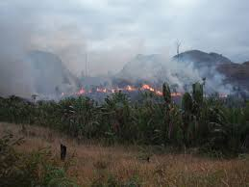
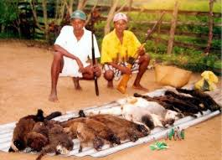
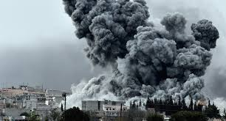
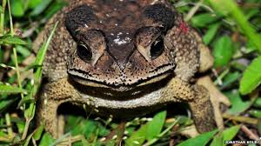
What are the threats to biodiversity and ES?
Some natural causes may explain the loss of species or natural environments, but the current rate of erosion is largely attributable to human activities.
Five major causes of loss of biodiversity have been identified:
• The destruction and fragmentation of natural environments linked, in particular, to agriculture, urbanization and the development of transport infrastructure;
• Overexploitation of wild species: overfishing, deforestation, poaching ...;
• Pollution of water, soil and air;
• The introduction of invasive alien species;
• Climate change that can add to and aggravate other causes of loss. It changes the living conditions of species, forcing them to migrate or adapt their way of life, which some are not able to do.

Slide 13
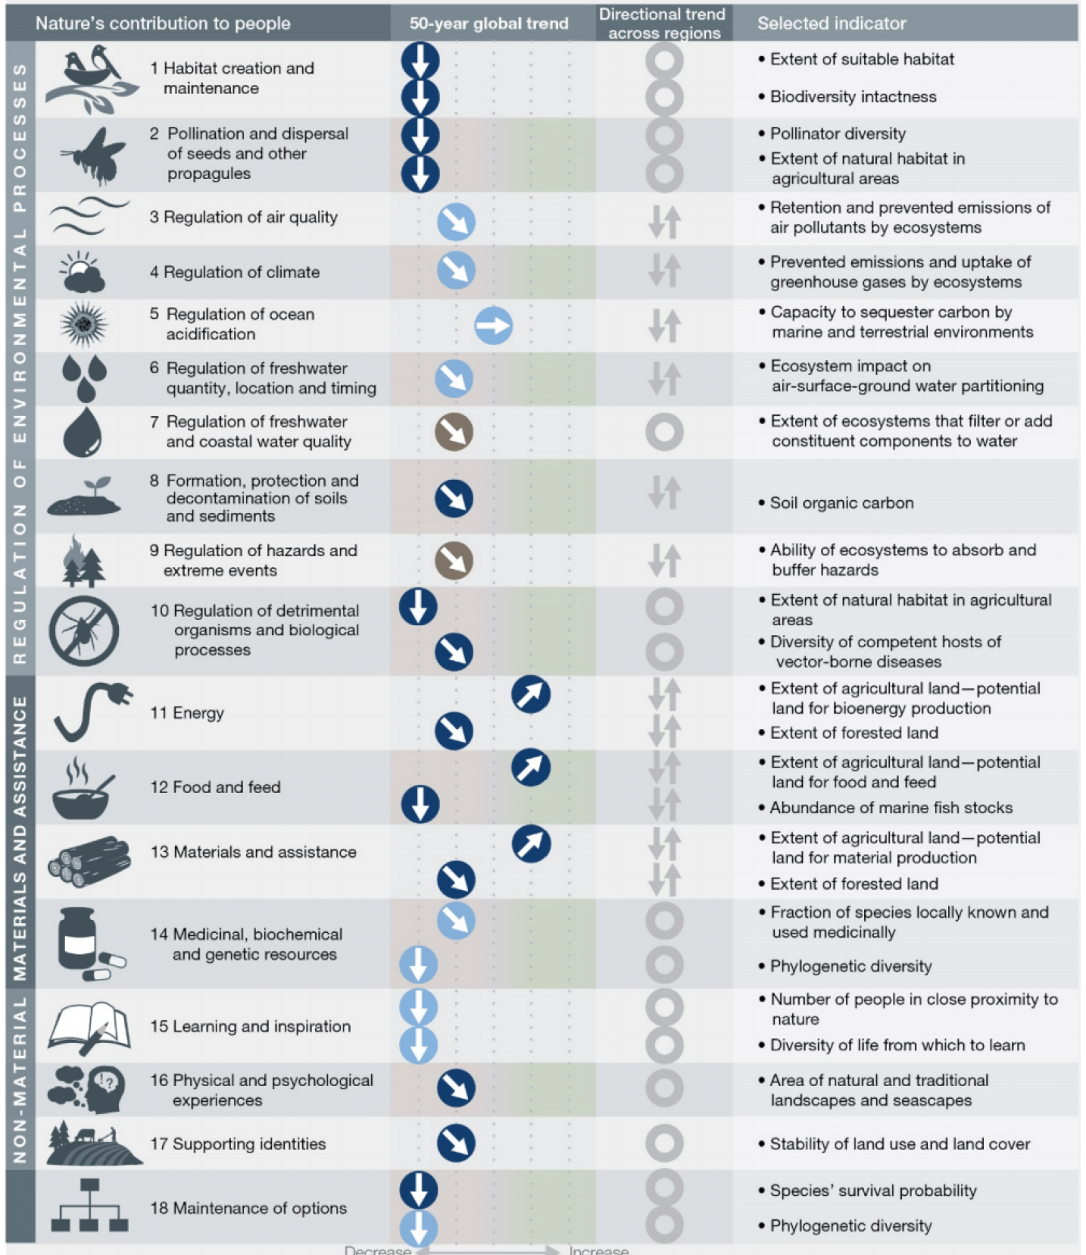
IPBES report, 2019: Worrying evidence!
75% of the earth’s land surface has already been significantly altered.
66% of the ocean area is experiencing increasing cumulative impacts.
Over 85% of wetlands (in terms of area) have been lost.
32 million hectares of primary or recovering forest were lost between 2010 and 2015.
The average abundance of native species in most major terrestrial biomes has fallen by 20% since 1900. This may be accelerating.
Agricultural crop production has increased threefold since 1970, and raw timber harvest by 45%. But soil organic carbon and pollinator diversity have declined – so these gains weren’t sustainable.
Land degradation has reduced productivity in 23% of the global terrestrial area.
Annually, US$235 to $577 billion of global crop output is at risk from pollinator loss.
Loss of coastal habitats and coral reefs increases risk of floods and hurricanes, particularly to 100-300m people.
Notes:
Source:

Slide 14
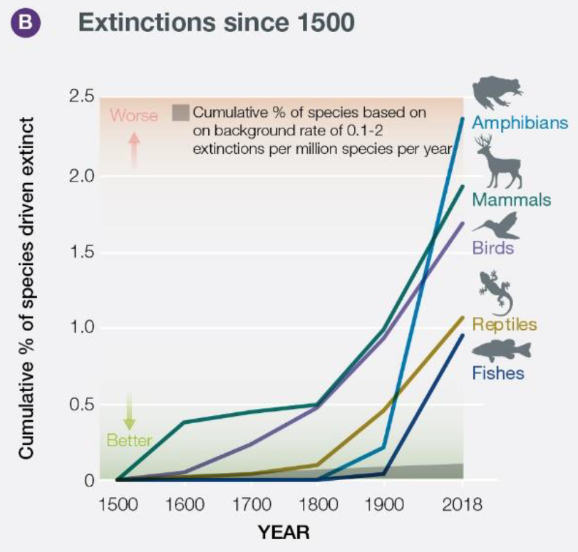
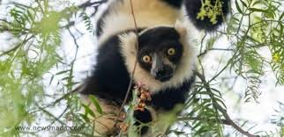
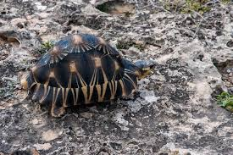
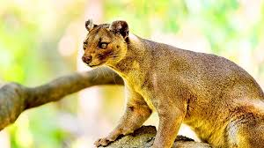
How many species are in danger?
The International Union for the Conservation of Nature (IUCN) publishes a global inventory of the conservation status of species: the Global Red List of Threatened Species.
In the latest edition of the Global Red List (2019 version), 27% of the 105,732 species assessed are threatened, including 32% of amphibians, 21% of mammals, 13% of birds, 27% of corals, and 43% of flowering plants.
‘..around 1 million species already face extinction, many within decades, unless action is taken to reduce the intensity of drivers of
biodiversity loss.’ (IPBES, 2019)
(IPBES, 2019)
Notes:
Species Status by IUCN: Extinct (EX), Wild Eider (EW), Critically Endangered (CR), Endangered (EN), Vulnerable (VU), Near Threatened (NT), Least Concern (LC) , Data Deficient (DD), Not Evaluated (NE).

Slide 15
What are the dangers from losing biodiversity?
Loss of biodiversity and ecosystem services is dangerous for humanity. It risks our stable environment and stable economy.
Prosperity and poverty reduction depend on maintaining the flow of benefits from biodiversity and ecosystems. For example:
Halving deforestation rates by 2030 would reduce global greenhouse gas emissions by 1.5 to 2.7 GT that would cause US$ 3.7 trillion of damage.
Over-exploitation of most commercially valuable fish stocks reduces the income from global marine fisheries by US$ 50 billion annually.
According to IPBES, annually, US$235 to $577 billion of global crop output is at risk from pollinator loss.
Sources: TEEB and IPBES
Notes:
IPBES 2019 report and TEEB – Mainstreaming the Economics of Nature – 2010.
http://doc.teebweb.org/wp-content/uploads/Study%20and%20Reports/Reports/Synthesis%20report/TEEB%20Synthesis%20Report%202010.pdf:
Halving deforestation rates by 2030 would reduce global greenhouse gas emissions by 1.5 to 2.7 GT CO2 per year, thereby avoiding damages from climate change estimated at more than US$ 3.7 trillion in NPV terms. This figure does not include the many co-benefits of forest ecosystems (Eliasch 2008).
Competition between highly subsidized industrial fishing fleets coupled with poor regulation and weak enforcement of existing rules has led to over-exploitation of most commercially valuable fish stocks, reducing the income from global marine fisheries by US$ 50 billion annually, compared to a more sustainable fishing scenario (World Bank and FAO 2009).
Although just covering 1.2% of the world’s continent shelves, coral reefs are home to an estimated 1-3 million species, including more than a quarter of all marine fish species (Allsopp et al. 2009). Some 30 million people in coastal and island communities are totally reliant on reef-based resources as their primary means of food production, income and livelihood (Gomez et al. 1994, Wilkinson 2004).
Global sales of organic food and drink have recently been increasing by over US$ 5 billion a year, reaching US $46 billion in 2007 (Organic Monitor 2009); the global market for eco-labelled fish products grew by over 50% between 2008 and 2009 (MSC 2009); and ecotourism is the fastest-growing area of the tourism industry with an estimated increase of global spending of 20% annually (TIES 2006).
Bee keeping generates US$ 213 million annually in Switzerland: A single bee colony ensured a yearly agricultural production worth (US$ 1,050) in pollinated fruits and berries in the year 2002, compared to just US$ 215 for direct products from beekeeping (e.g. honey, beeswax, pollen) (Fluri and Fricke 2005). On average, Swiss bee colonies ensured a yearly agricultural production worth about US$ 213 million by providing pollination, about five times value of the production of honey (TEEBcase: Valuation of pollination spurs support for bee keepers, Switzerland). The →total economic value of insect pollination worldwide is estimated at €153 billion, representing 9.5% of world agricultural output in 2005 (Gallai et al. 2009).
Local authorities in Canberra have planted 400,000 trees to regulate microclimate, reduce pollution and thereby improve urban air quality, reduce energy costs for air conditioning as well as store and sequester carbon. These benefits are expected to amount to some US$ 20-67 million over the period 2008-2012, in terms of the value generated or savings realized for the city (Brack 2002).

Slide 16
Biodiversity and Ecosystem Services Module –
Take home messages
Biodiversity is the variety of life on earth, at the ecosystem, genetic and species levels.
It provides ecosystem services essential to life, from food and medicines to purification of the air we breathe, regulation of water, creation and stabilisation of soil, pollination of crops, protection from floods and disasters and help adapting to climate change.
Biodiversity is being lost at an unprecedented rate, particularly through destruction and fragmentation of natural environments, overexploitation of wild species, pollution, introduction of invasive alien species and climate change.
Recent reports such as the global assessment report of biodiversity and ecosystem services (IPBES, 2019) offer very worrying evidence. Many studies reveal the impact on people’s lives and the economy of such losses.

